Slide 1

Welcome
xdtinker

Slide 2
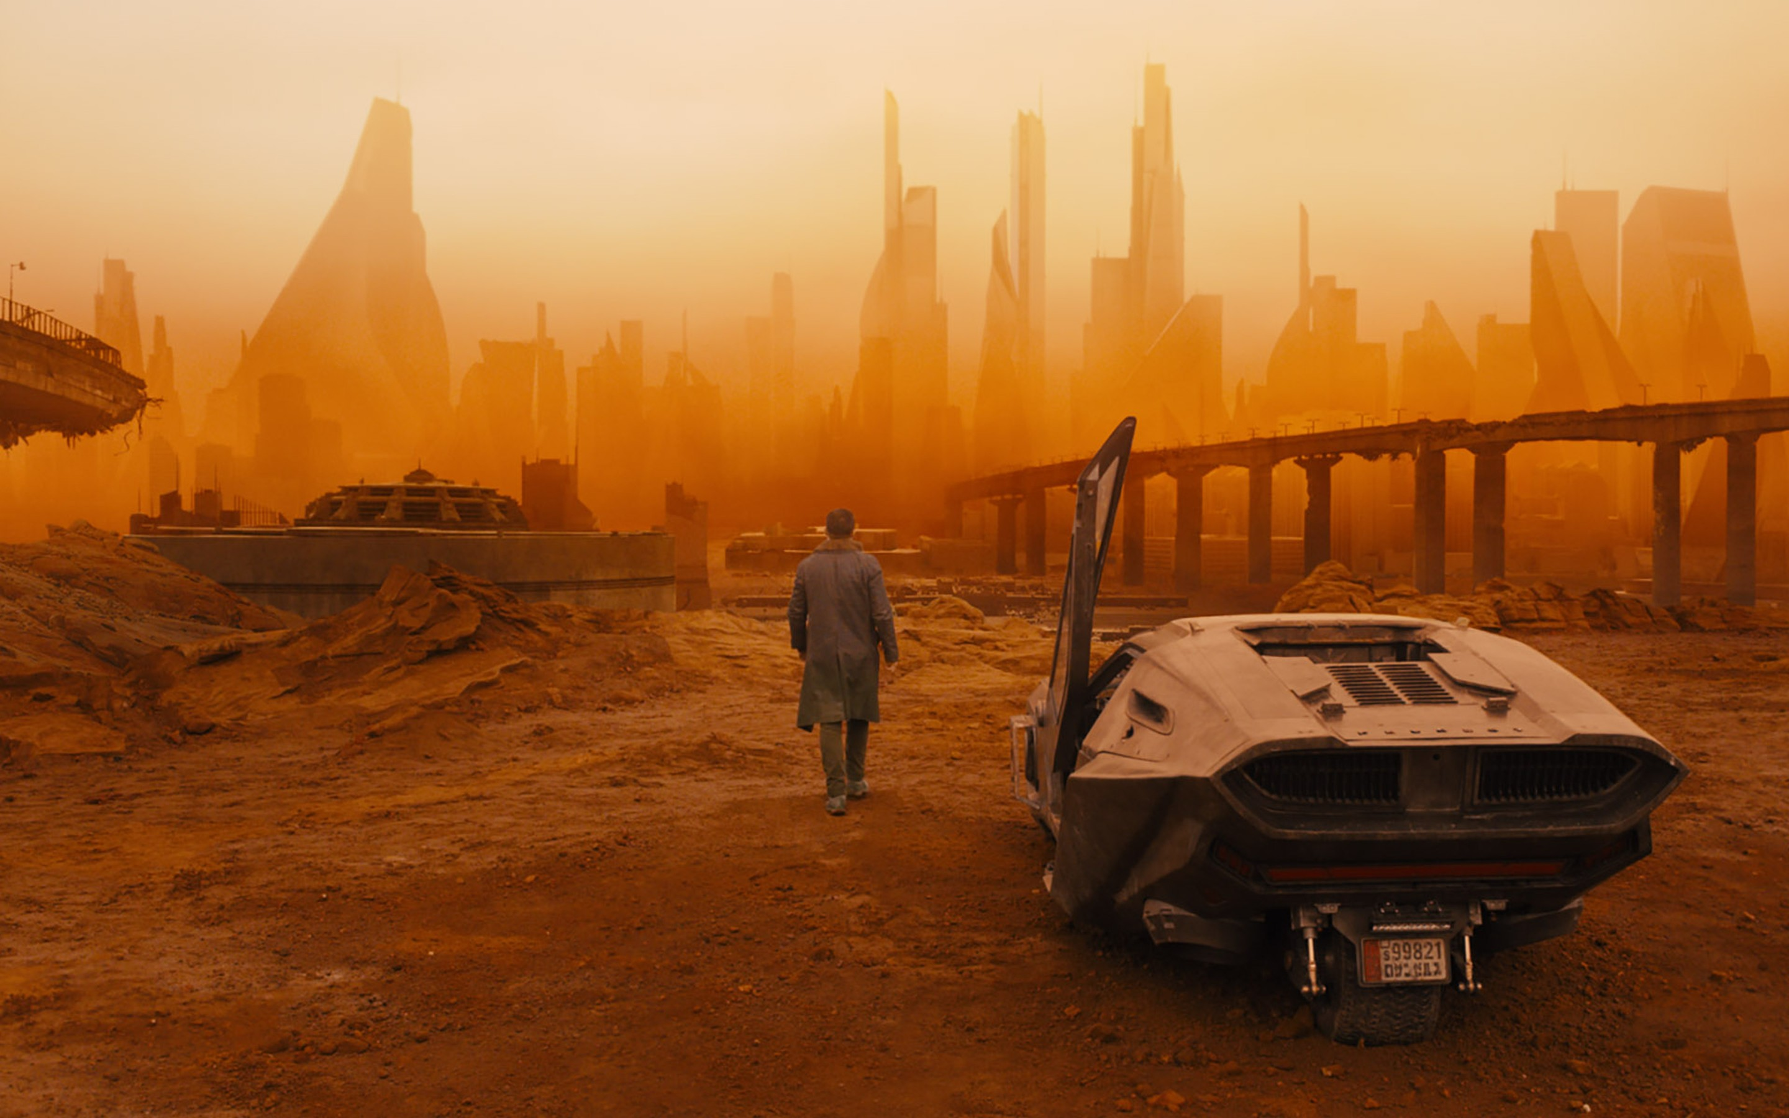




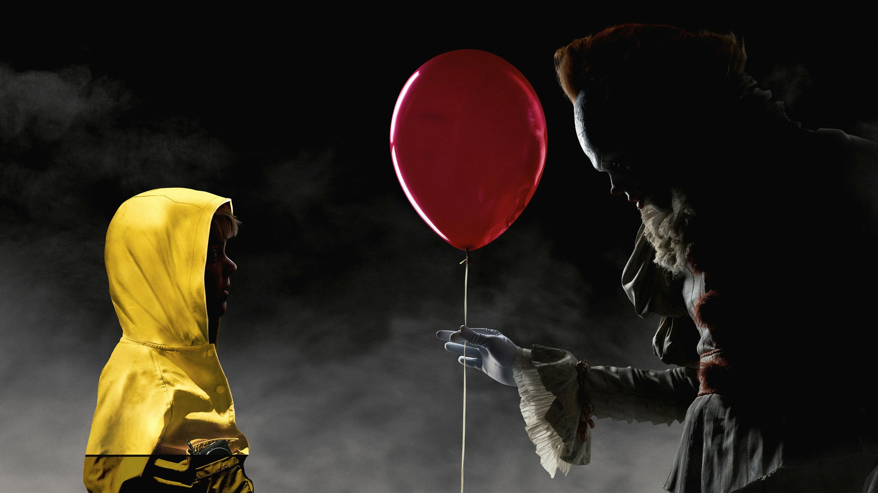
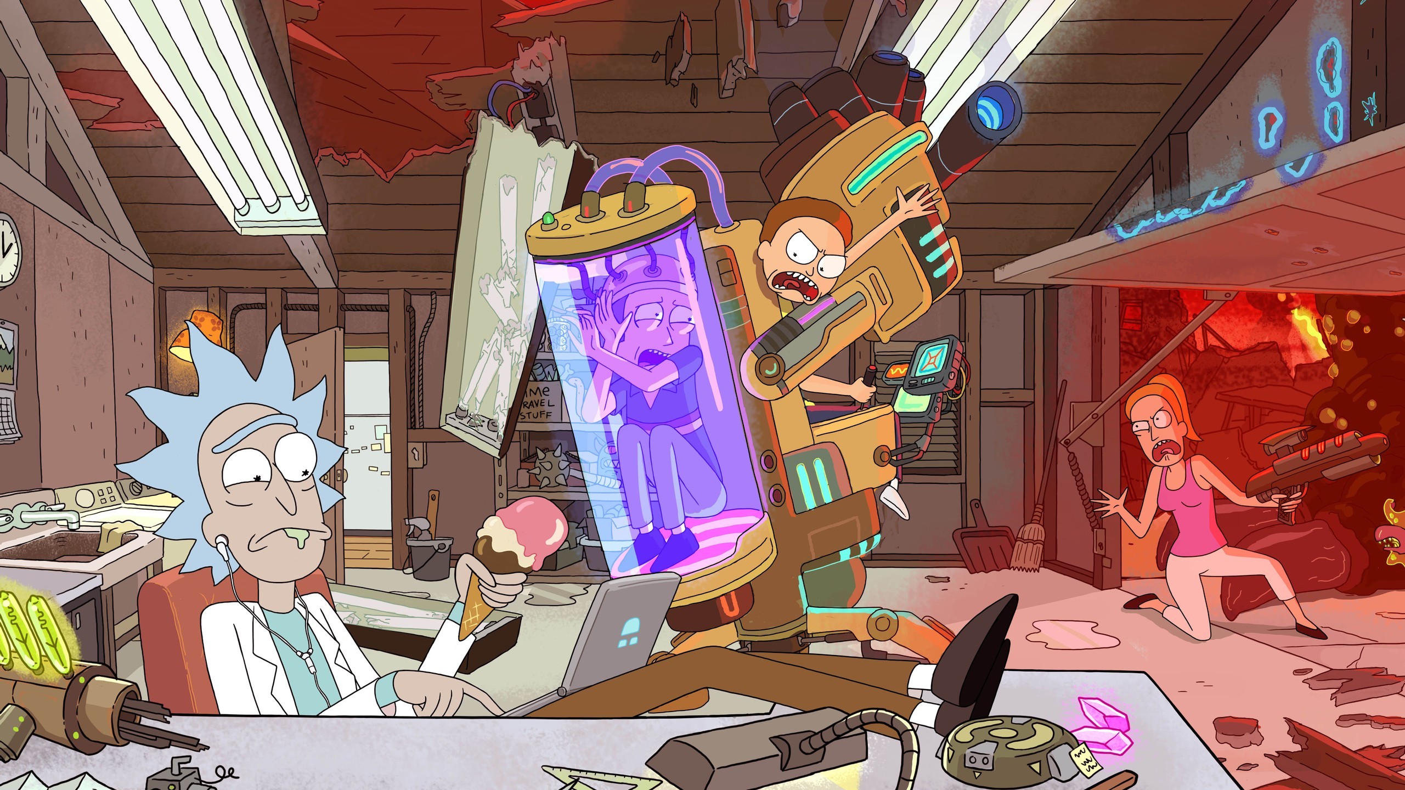
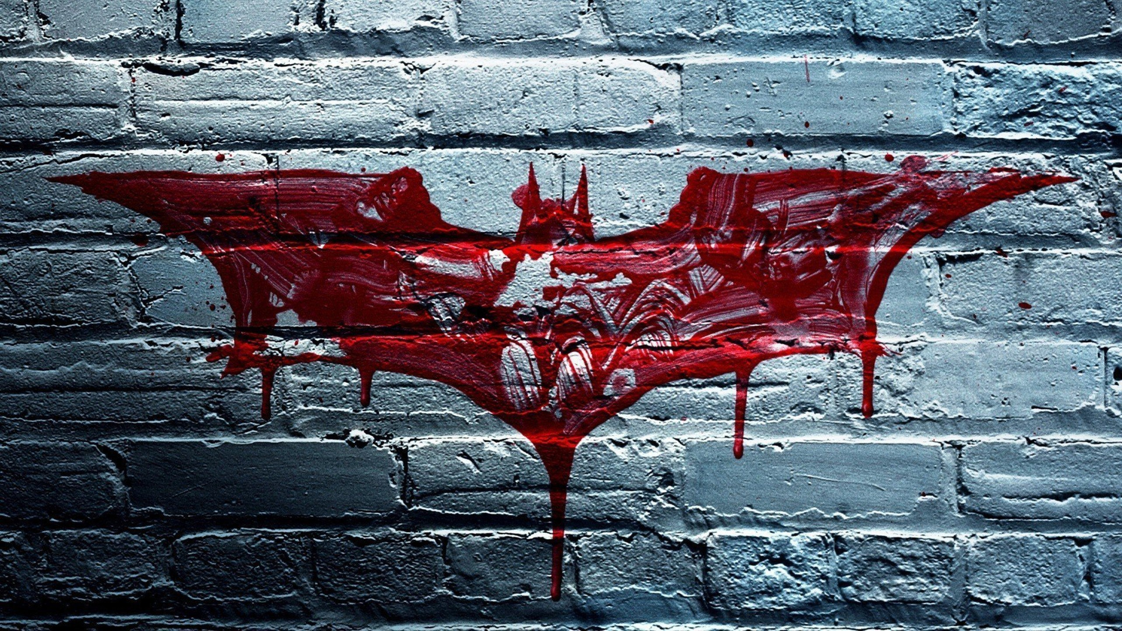
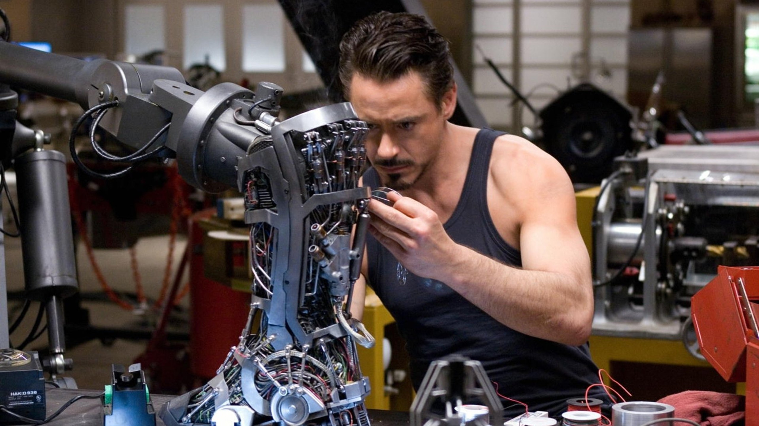
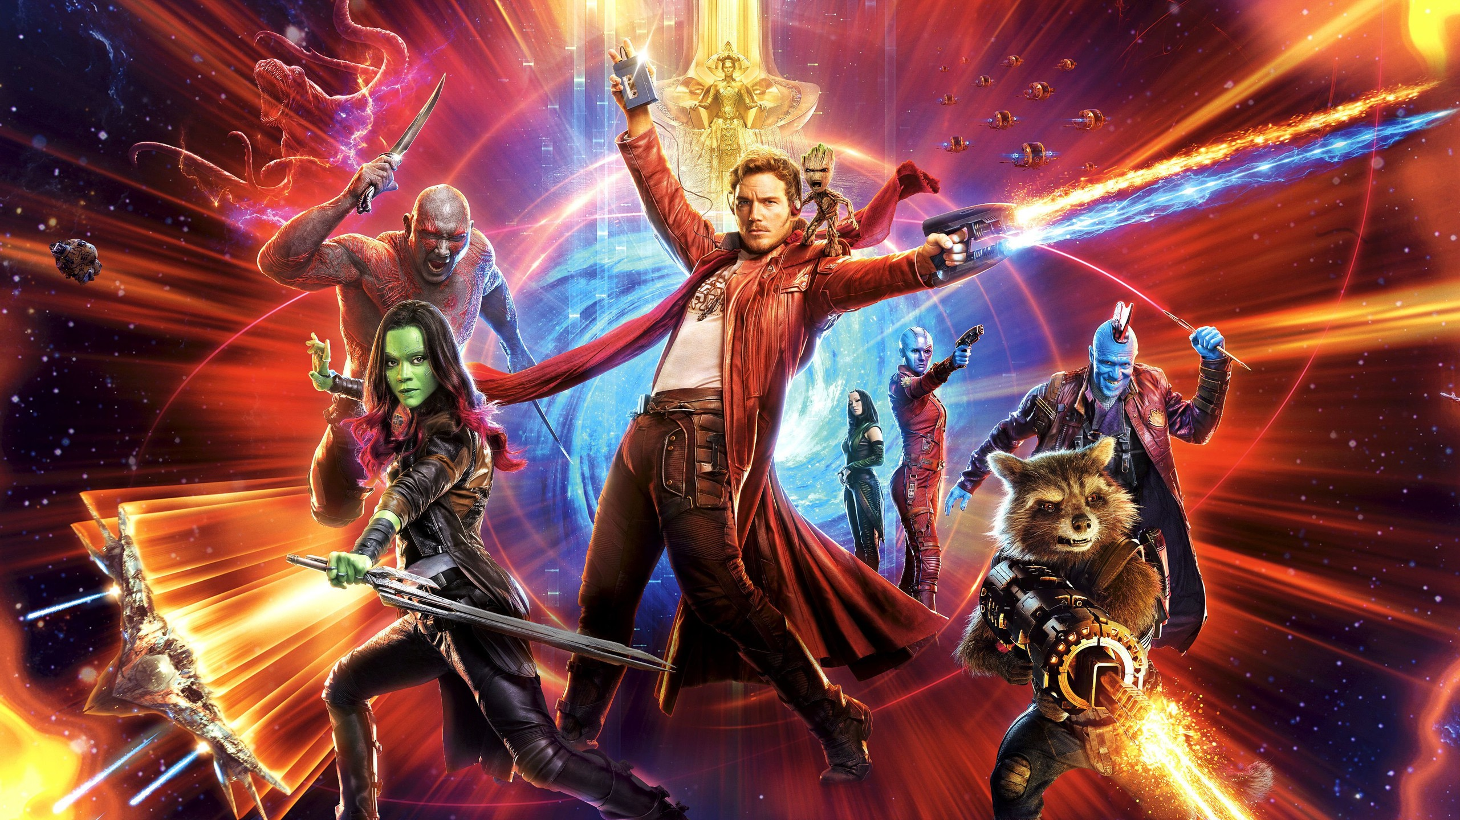

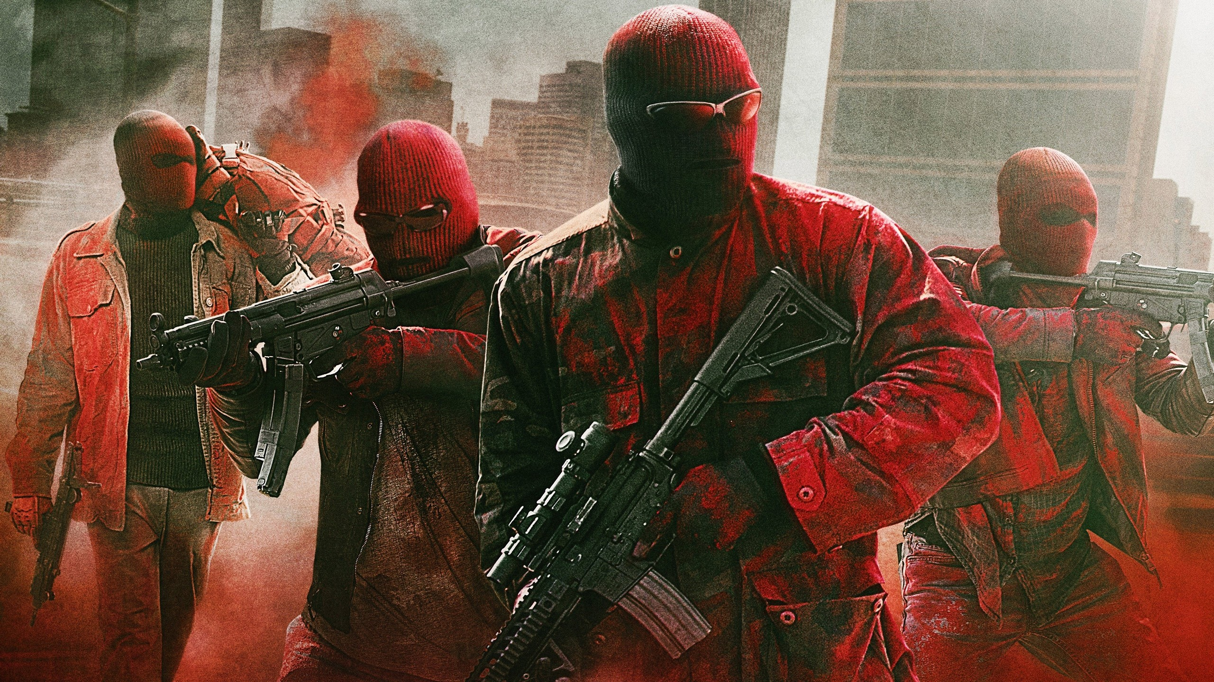
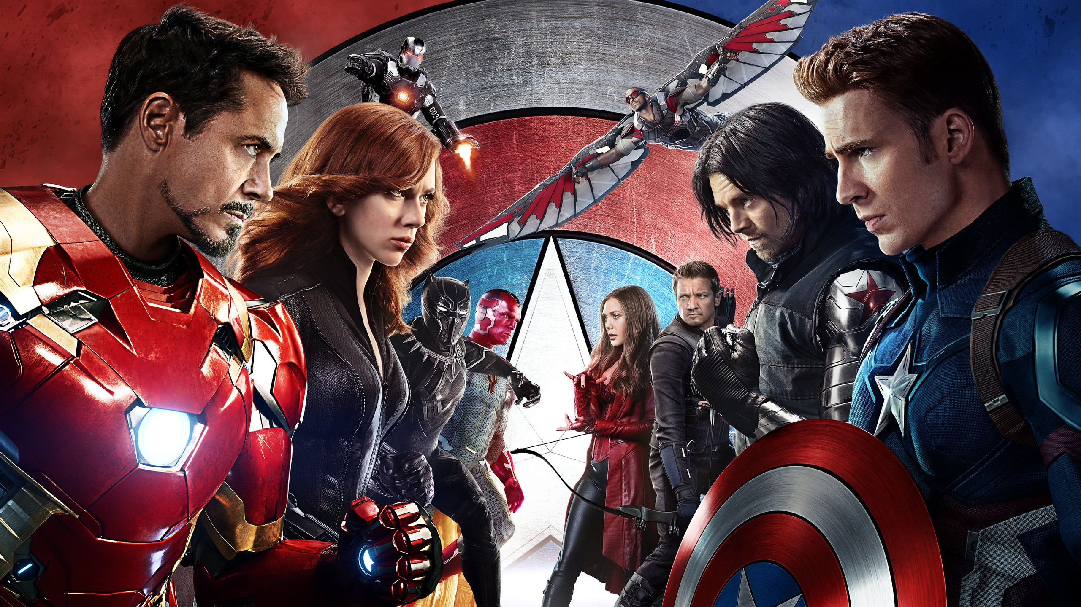

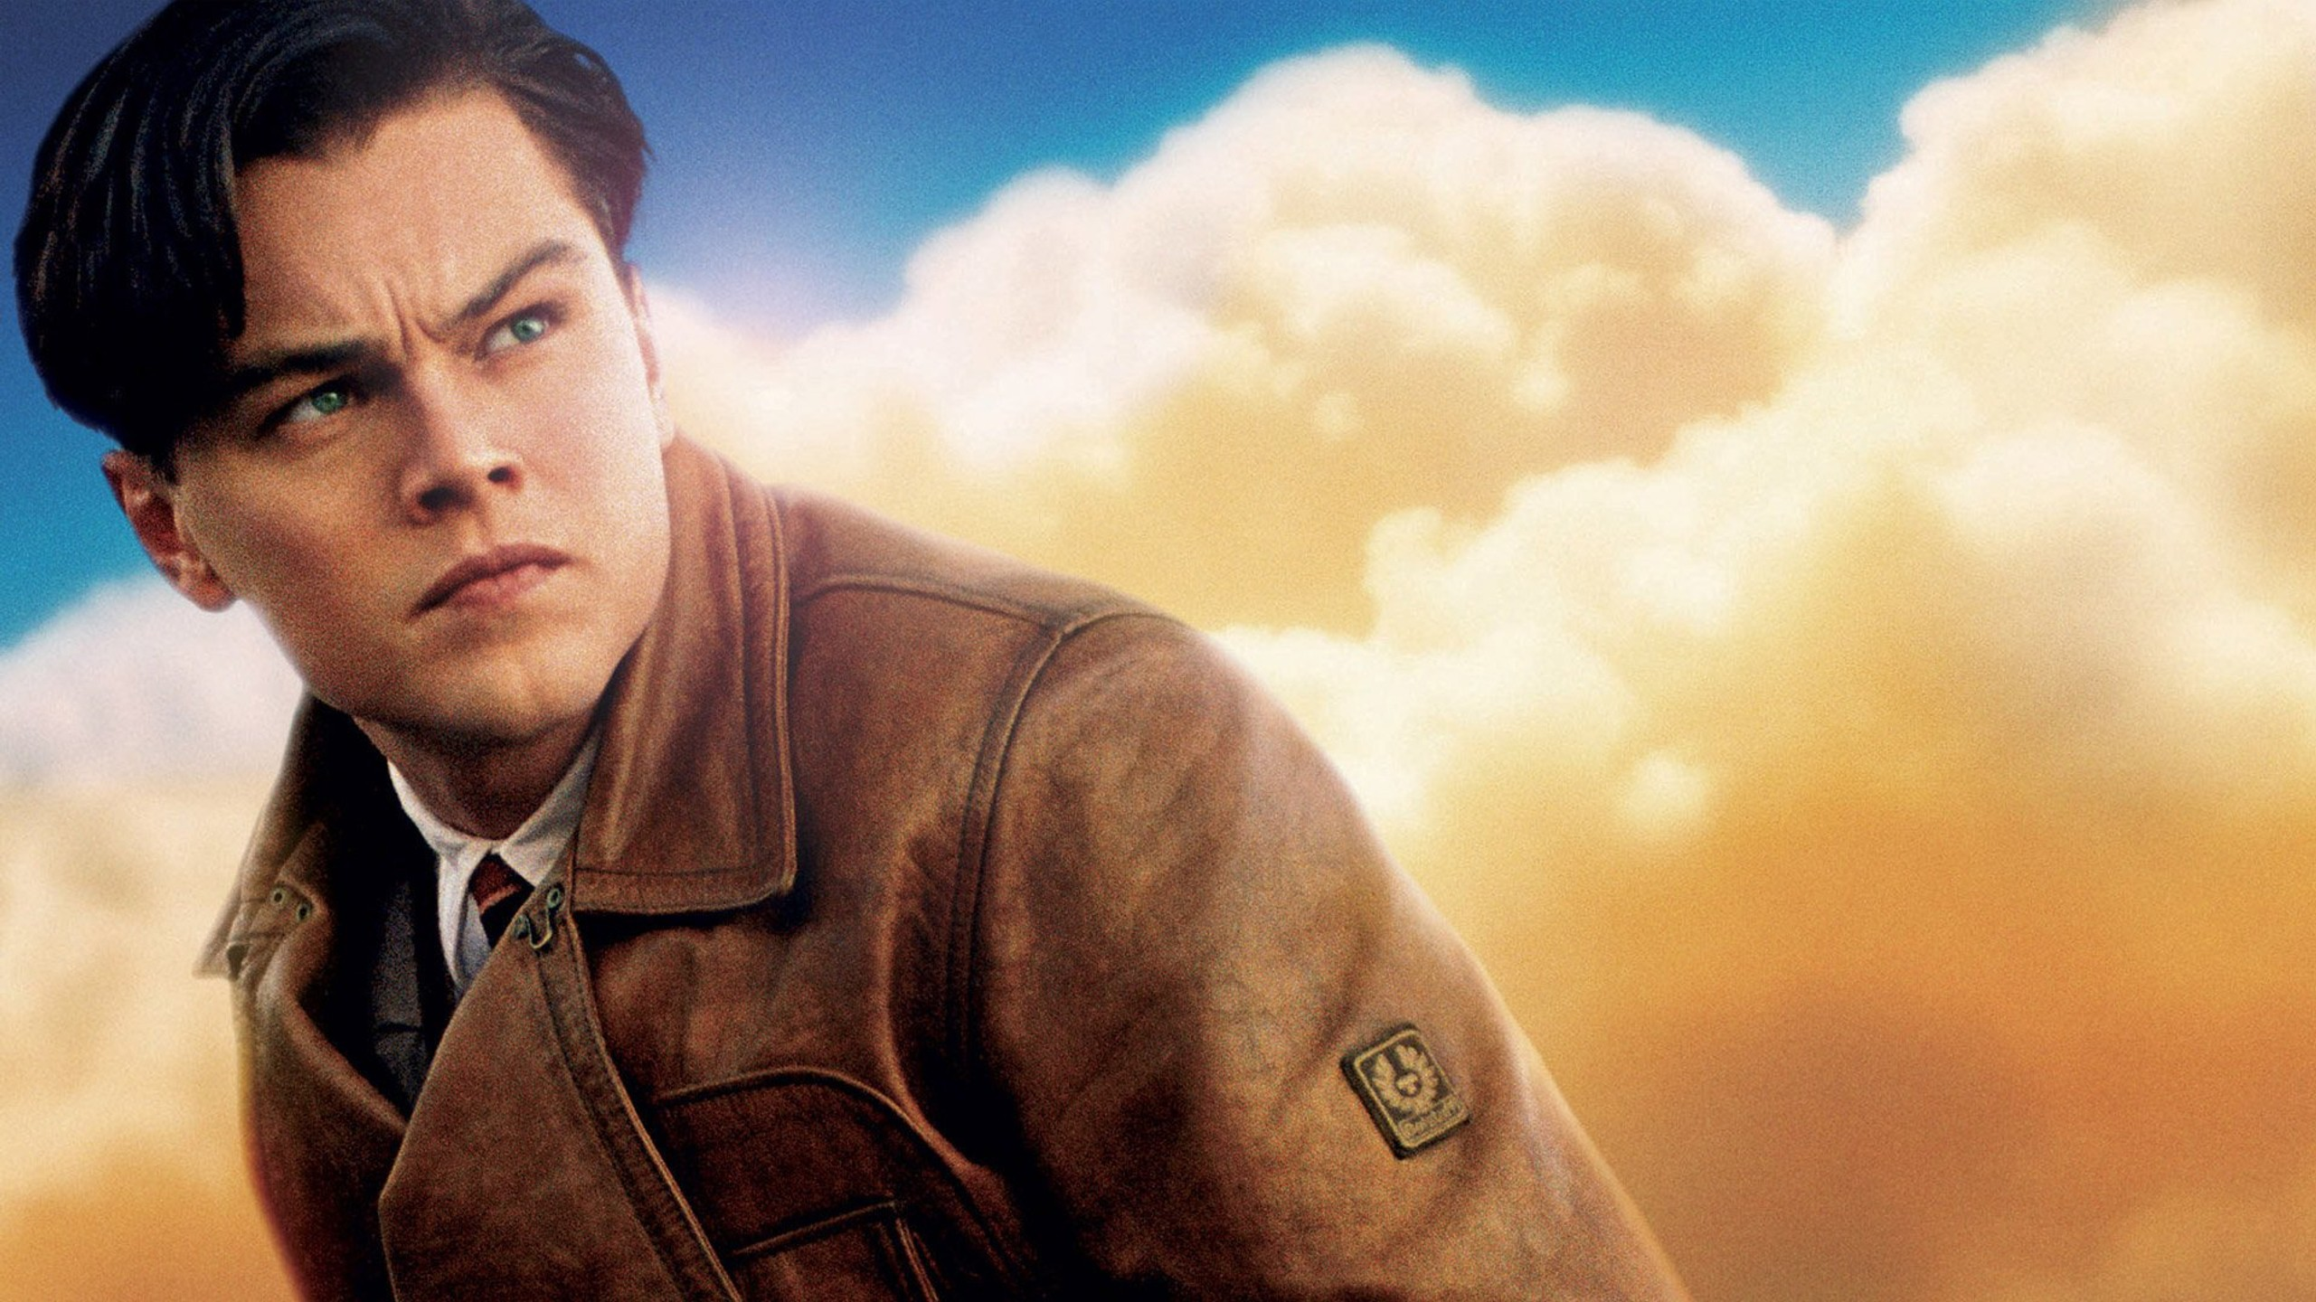
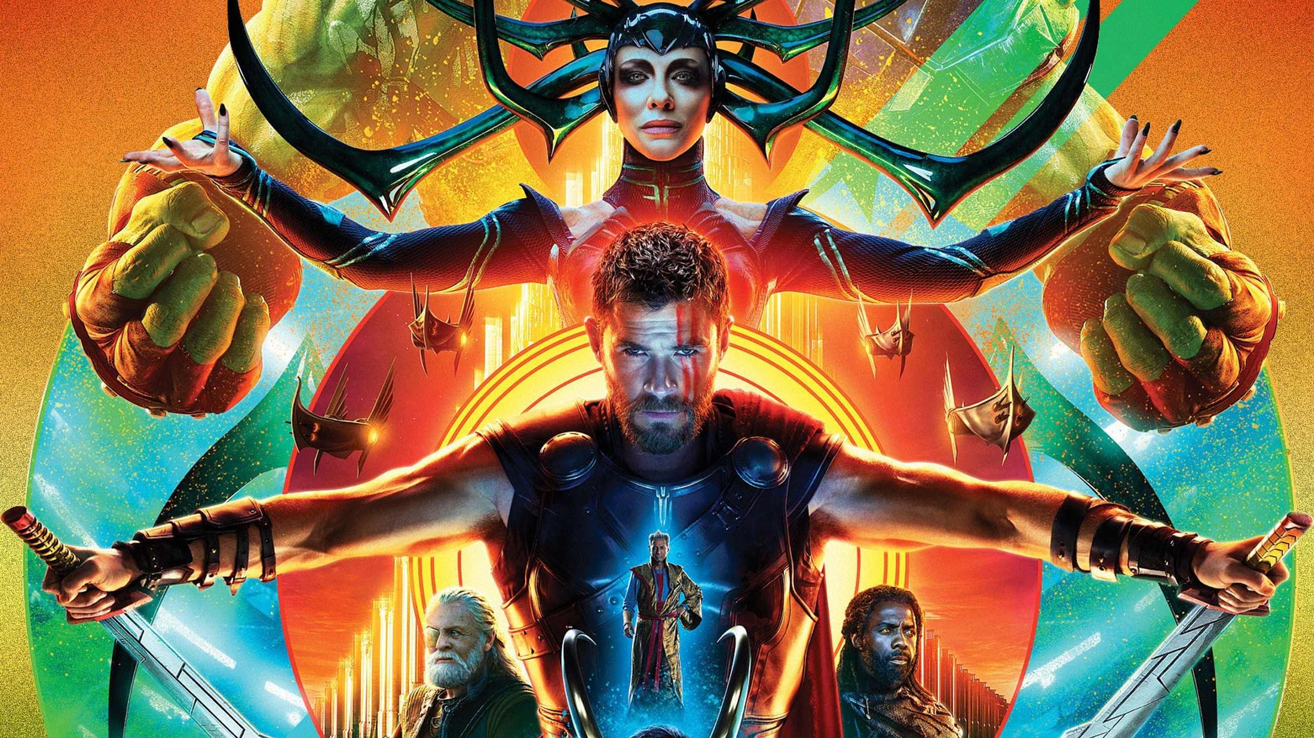
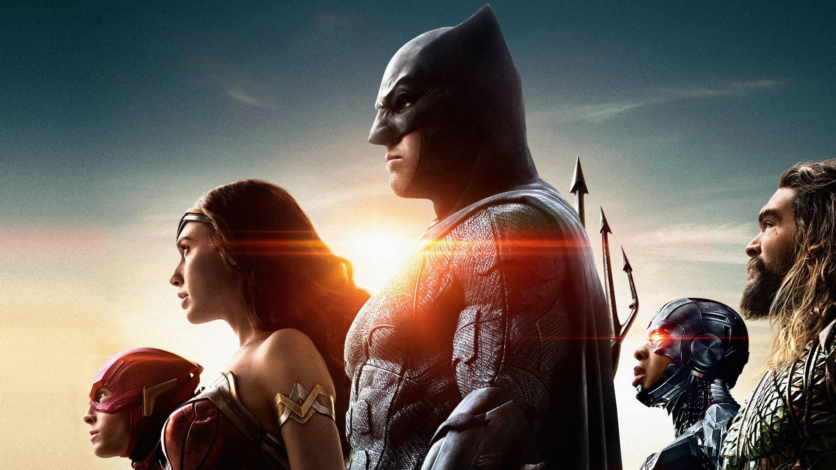
xdtinker
PREMIUM
Search
Blade Runner 2049
2017
PLAY
TRAILER
Officer K (Ryan Gosling), a new blade runner for the Los Angeles Police Department, unearths a long-buried secret that has the potential to plunge what's left of society into chaos. His discovery leads him on a quest to find Rick Deckard (Harrison Ford), a former blade runner who's been missing for 30 years.
Recently added

